Slide 1
Jumpstart tourism
A revolutionary idea in the context of the EU-VS-VIRUS Hackathon
<put names here>

Slide 2


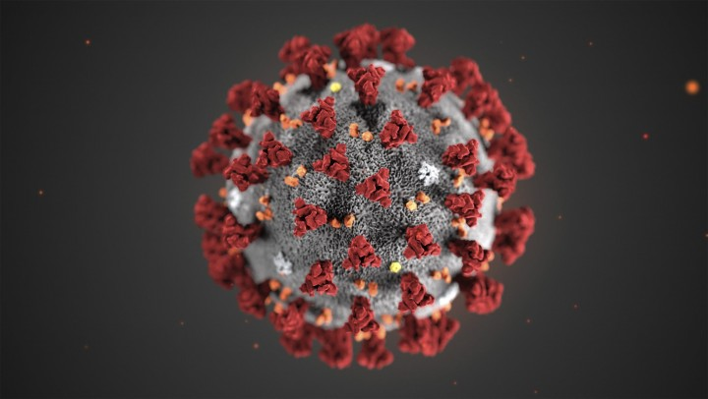




COVID-19 and TOurism
Hopeless?
Markus
Runs a local restaurant
Rachel
Tour guide
Annabelle
Owns a BnB
This Photo by Unknown Author is licensed under CC BY
This Photo by Unknown Author is licensed under CC BY-SA-NC
This Photo by Unknown Author is licensed under CC BY-NC-ND

Slide 3
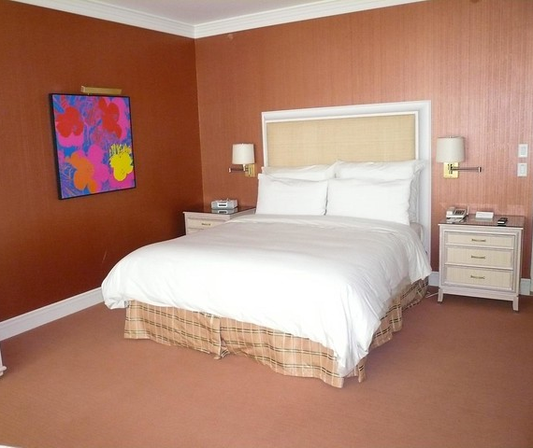
Annabelle
Owns a BnB
Currently no Hotel Bookings allowed
Wants to offer her service to “certified healthy” guests
This Photo by Unknown Author is licensed under CC BY-SA

Slide 4
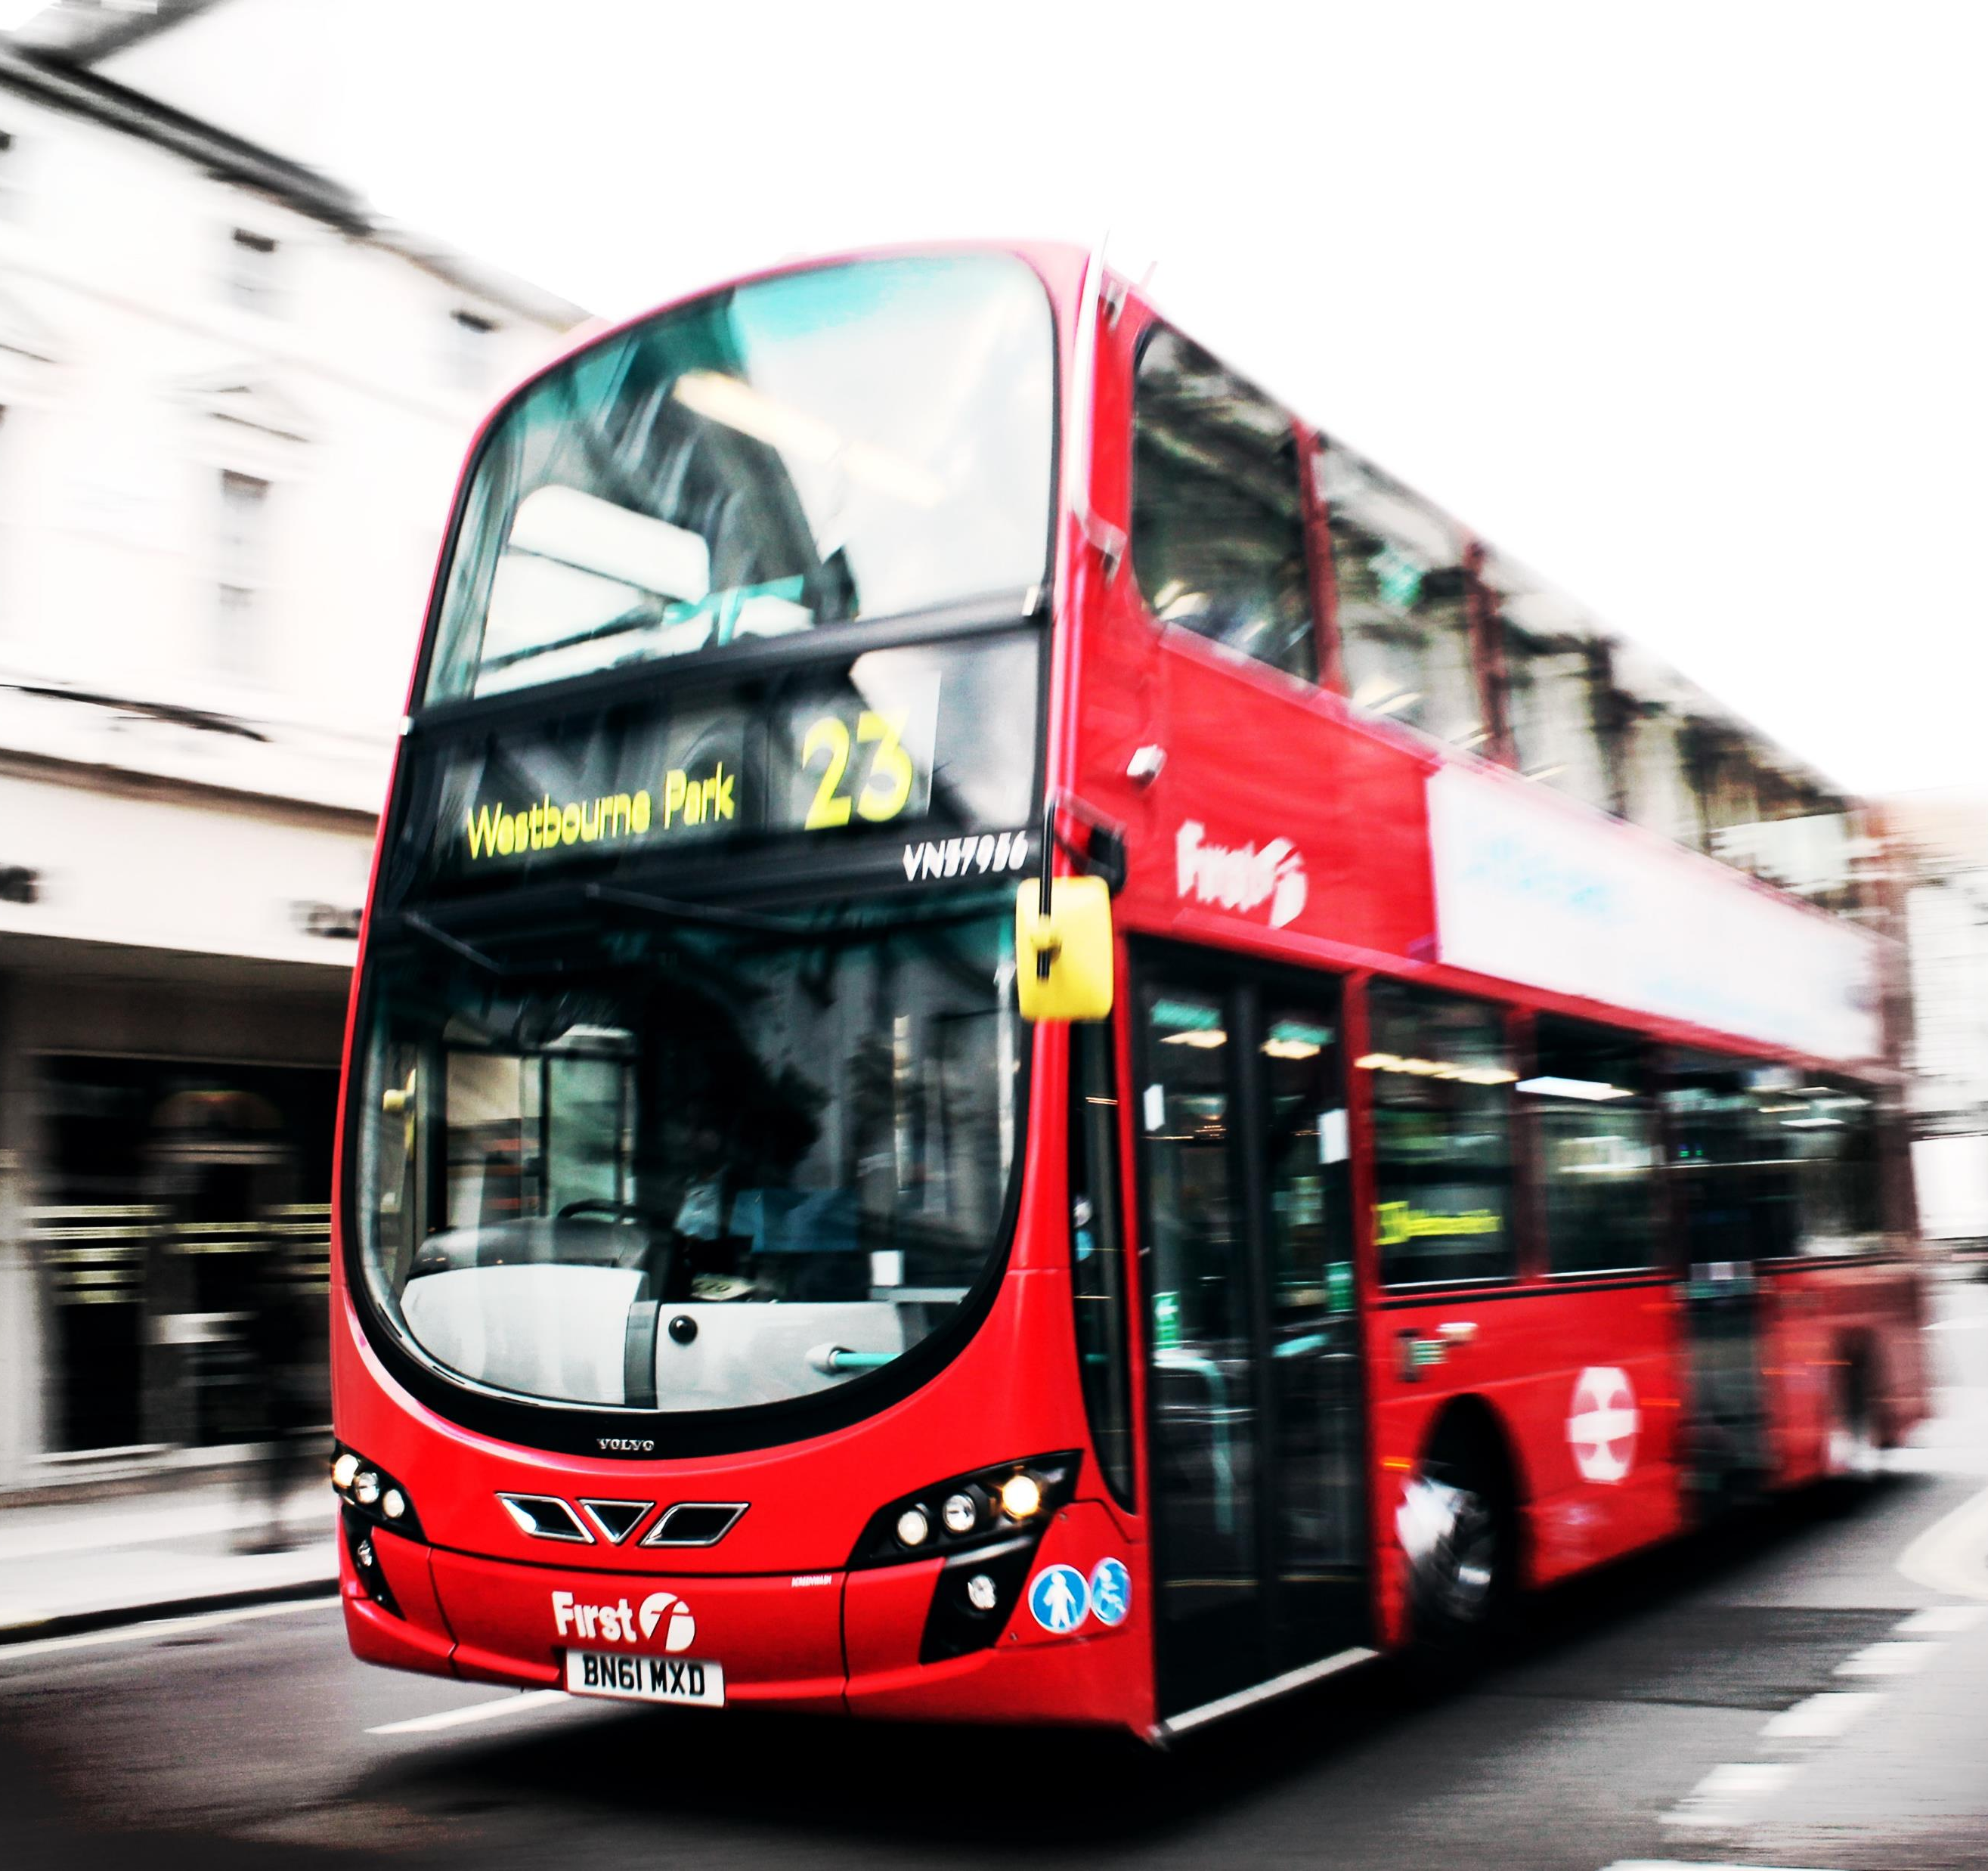
Rachel
Tour guide
No people in tour buses?
Wants to show her City to “Certified Healthy” Guests

Slide 5
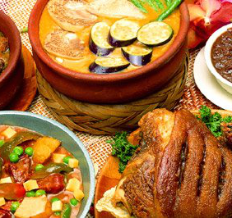
Markus Runs a local restaurant
No people coming to eat?
Wants to serve traditional meals to “Certified healthy” Guests
This Photo by Unknown Author is licensed under CC BY-SA

Slide 6

Jumpstart!
Platform for local businesses – preference SME
Local Networks of Trust – healthy and trustworthy
Building tourist stories – Focus: China
Tourism preference: organised tours with strict agenda
Image: show a positive China to the world
COVID Status: first wave basically over
This Photo by Unknown Author is licensed under CC BY-NC

Slide 7
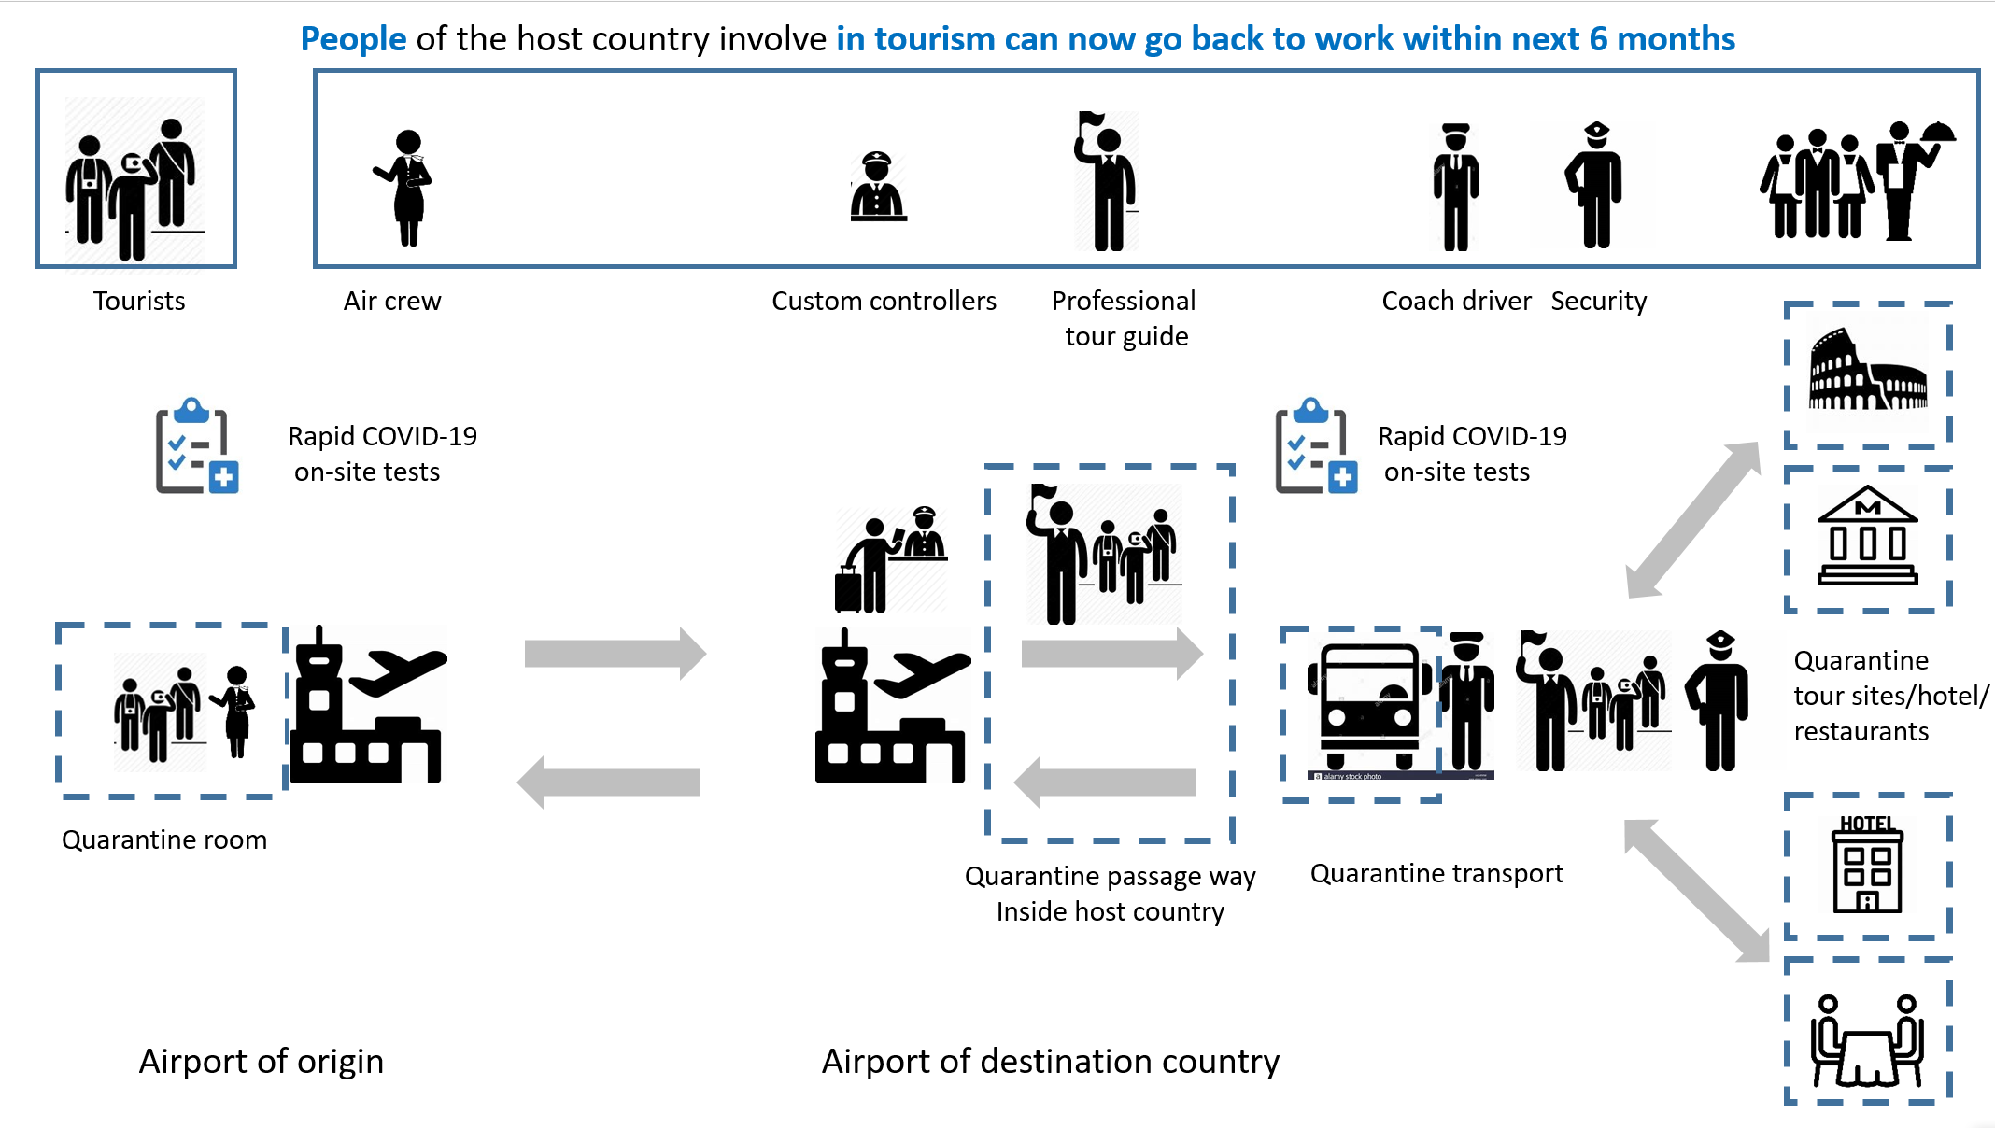

Slide 8
JUMPSTART!
Cultural Exchange in the “New Normal”: A way out of Isolation
Bring People “Back to Normal”
Give new Hope to Tourism Sector
Controlled Environment
Well documented process
Platform: connect people and Businesses

Slide 9
Open points
Responsibilities
Businesses themselves
Tourists
Platform
Politics
Delivery
Contacts to political decision makers Bottom up or top down?
Privacy
Processes for logistics and emergency procedures

